Slide 1
Node Js
Node.js® is a JavaScript runtime built on Chrome's V8 JavaScript engine.

Slide 2
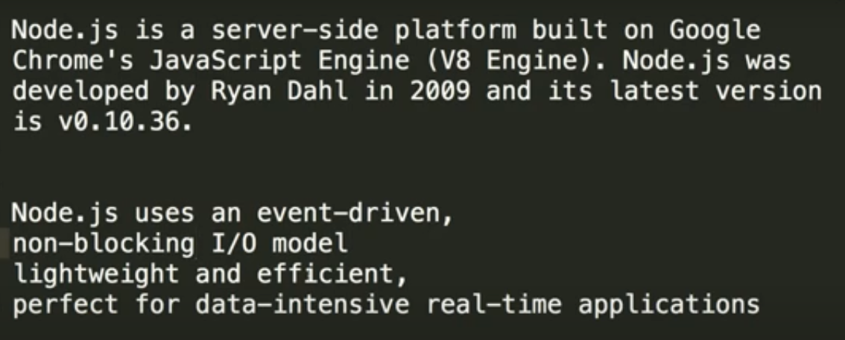
Introduction to Node.js

Slide 3
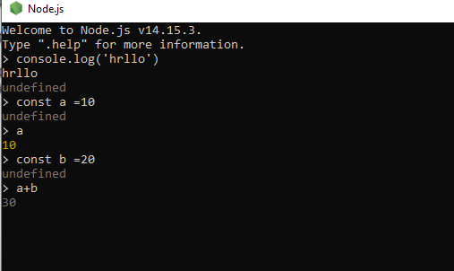
Node (ctrl+c)exit

Slide 4
RUN :node main
node --version
npm --version
npm (package install)
npm command : -npm init
npm install express --save
npm i (install)
npm i -g nodemon (package)
nodemon main.js

Slide 5
Dev dependency
ye bo dependency h jo devlpment ke time par use karna chahege..
npm install --save-dev nodemon
npm uninstall nodemon
npm uninstall ex
----
npm i express
npm i @angular/cli

Slide 6
Import export file data
const ram = require("./second");
console.log("hello world",ram)
module.exports =pn;

Slide 7
module wrapper function in nodejs

